Slide 1
Do you Suffer From Chronic Pain? Learn More About Alternative Treatments
WE WILL BEGIN SHORTLY
NM-967606-AA

Slide 2
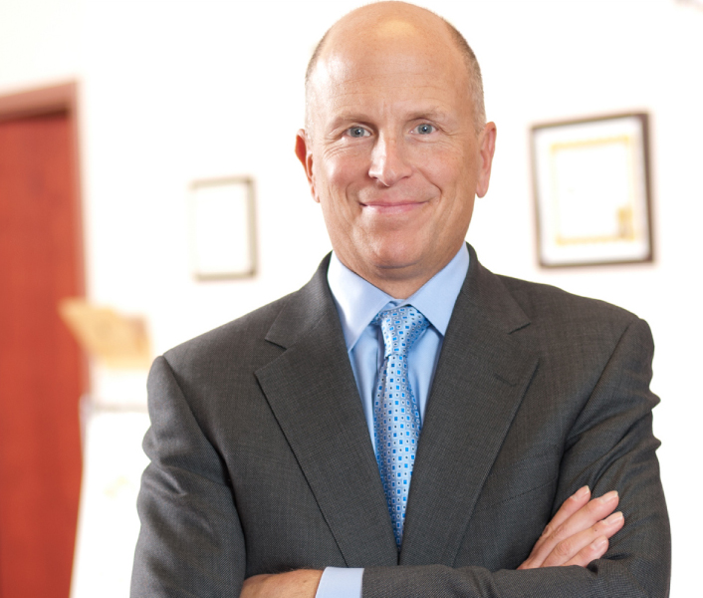
Scott Glaser, MD DABIPP
Interventional Pain Management
Pain Specialists of Greater Chicago
7055 High Grove, Suite 100 Burr Ridge, IL 60527 630.371.9980

Slide 3
Today, we will:
Learn about chronic pain treatment options
See what options may work best for
your personal chronic pain
Suggest things for you to discuss at your next appointment
Welcome!
Treatment options for your journey with Chronic Pain

Slide 4
Symptoms occurring with or without trigger
Weakness
First it’s important to understand there are different types of pain
Mechanical or Neuropathic Pain
Numbness
Pins and needles
Shooting, burning, stabbing pain

Slide 5
Does chronic pain prevent you from enjoying …
Being able to perform basic tasks around the house
The ability to work and be productive
Playing with children or grandchildren
Being sexually active
Gardening, arts and crafts, etc.
Outdoor activities such as walking and hiking

Slide 6
You have probably already tried many of these therapies
Treatment Options
NSAIDs
Physical Therapy
TENS
Opioids
Drug Pumps
Surgical Intervention
Nerve Blocks

Slide 7
Radiofrequency Ablation
Now let’s talk about 3 options you may not have tried yet …
Indirect Decompression
Spinal Cord Stimulation

Slide 8
Radiofrequency Ablation pain management (RFA)
RFA is the application of heat to small areas of nerve tissue so that the nerves no longer transmit pain signals.
Minimally invasive outpatient procedure. Consider using if medication and steroid
injections have failed to control the pain.
Your pain physician can perform a simple test called a diagnostic block to see if RFA
might be effective for you.
Treats pain in:
Back Knees
Hips Neck
DISABLE NERVE
The procedure can be repeated if the pain returns when the nerves regenerate.
PROBE

Slide 9
Next,
lets talk about the VERTIFLEX® PROCEDURE*
*Superion® Indirect Decompression System (IDS)

Slide 10
The VERTIFLEX® PROCEDURE*
*Superion® Indirect Decompression System (IDS)
Extension provokes symptoms Patients lean forward while Sitting (flexion) relieves
walking to move around symptoms
Pain/weakness in legs _{more comfortably,}
“Shopping Cart” sign

Slide 11
What is lumbar
spinal stenosis?
A gradual narrowing of the space in the spine where nerves pass through
The narrowing can cause a “pinching” on the lower back nerves resulting in aching, dull back pain in the back, buttocks and legs.

Slide 12
VERTIFLEX PROCEDURE. FOR LSS
The Vertiflex Procedure is a simple₁ minimally invasive treatment which can provide effective₁ long-term relief.
FDA approved
Small incision
Same-day procedure
Does not require removal of bone or tissue
Speedy recovery time
Low risk of infection or complications ³
Can provide long-term relief
More than 20,000 patients treated since 2016
BEFORE VERTIFLEX PROCEDURE
AFTER VERTIFLEX PROCEDURE
Spacer provides relief off the pinched nerves
Pinche. d nerv. es
causing pain
*Superion Indirect Decompression System (IDS)
Among clinical study completers; Nunley PD,et al. Five-year durability of stand-alone interspinous process decompression for lumbar spinal stenosis. Clin lnterv Aging. 2017;12:1409-1417. Nunley, et al. Journal of Pain Research. 2018:11 2943-2948

Slide 13
VERTIFLEX® PROCEDURE*
for Lumbar Spinal Stenosis
A minimally-invasive outpatient procedure that uses a small implant that is placed in the lower back designed to minimize impact to the nearby bone or tissue.
The implant is designed to preserve space in the spine and to prevent crushing of the lower back nerves resulting in the reduction or elimination of leg and back pain.
This procedure can be performed in under one hour without general anesthesia.
About 10,000 procedures have been performed since receiving FDA approval in 2016. The procedure is completely reversible with a low risk of infection or complications.*
90% 85% 81% 75%
Patient Drop in opioid Improvement in Reduction in satisfaction usage physical function symptoms
*Superion Indirect Decompression System (IDS)
Source: Among clinical study completers; Nunley PD, et al. Five-year durability of stand-alone interspinous process decompression for lumbar spinal stenosis. Clin Interv Aging. 2017;12:1409-1417. Nunley, et all Journal of Pain Research.2018:11 2943-2948

Slide 14
Now,
let's discuss SPINAL CORD STIMULATION

Slide 15
Who can benefit from Spinal Cord Stimulation?
Common Diagnosis
Neuropathic pain in the low back and/or leg(s).
Failed back surgery syndrome
Have you been in chronic pain and being treated
by a pain specialist for over six months?
Do you have Pain in your Back? Legs? Feet?
Do you have neuropathy? CRPS? RSD?
Are you currently taking pain medication? Is your current average pain level a 5 or higher?
Have you already tried Physical therapy, TENS, Epidural, or Radiofrequency Ablation and still have pain?
SCS therapy is often considered when medications or surgery are not an option

Slide 16
NEUROMODULATION/ SPINAL CORD STIMULATION (SCS)
In use for over 40 years
FDA-approved
Non-Drug Therapy
May result in a reduction of oral drugs and their side effects
Covered by most insurance plans, including Medicare and most workers’ compensation programs
New improvements in technology have dramatically improved patient outcomes.
As with any surgery, there are risk of
complications
SCS therapy uses an implantable pulse generator (IPG) to interrupt pain signals coming from your lower back or legs.

Slide 17
Questions ???

